Slide 1
Sex Offenses & Sex Offender Registration Task Force
ICJIA Staff
John Maki, Executive Director
Mary Ratliff, Program Director
Erin Sheridan, Research Analyst

Slide 2
Guiding Principles
Protect Public Safety:
Policies for people with sex offenses must enhance community safety.
Use Evidence-Informed Practices:
Illinois laws and policies should be informed by research and practices shown to protect victims and reduce future offenses.
Allocate Resources Efficiently:
The state’s limited public resources should be invested in programs that do the most to prevent offending, lower recidivism, and improve outcomes for victims, families, and communities. Funding priority should be given to strategies that have demonstrated success.
Make Decisions Based on Assessments:
To better protect communities, law enforcement agencies must be able to differentiate between people who have high, moderate, and low risks and needs. Individualized assessments should be the basis for determining appropriate sanctions, treatment, and supervision.
Hold Individuals and Systems Accountable:
People must be held accountable for the harm they have caused to victims and communities with punishment that is proportional to the offense. The justice system also must be held accountable for preventing offending, reducing recidivism, increasing public safety, wisely using scarce resources, and supporting people in their efforts to lead positive and productive lives.

Slide 3
History of Sex Offender Registry in the US
Pre 1994: Few states required convicted sex offenders to register addresses with local law enforcement. The 1994 Jacob Wetterling Crimes Against Children and Sexually Violent Offender Act, required states to implement a sex-offender registration program. This was a law enforcement only registry, with no public component or public notification.
1996: Wetterling amended by Megan's Law. Required all states to conduct community notification, required the creation of Internet sites containing state sex-offender information but did not establish specific forms and methods.
Post 1996: Several pieces of legislation were passed to add offenses as well as add information required to report to sex offender registries. Despite these efforts, many sex offenders still failed to comply with registry laws.
Source: U.S. Department of Justice, Office of Justice Programs, SMART Office
Leslie A. Hagen, Assistant United States Attorney/ WDMI SMART Office
John Dossett,, General Counsel/NCAI

Slide 4
History of Sex Offender Registry in the US
The Adam Walsh Child Protection and Child Safety Act of 2006
Signed into law on July 27, 2006.
Covers States, territories, the District of Colombia, and Indian tribes.
Establishes uniform and comprehensive sex offender registration and notification requirements.
Authorized new programs and initiatives designed to combat crimes against children, expands sex offender registries, ensure sex offenders are held accountable for their crimes, prevents child pornography, and makes the Internet safer for children through authorizing Project Safe Childhood.
Establishes the SMART Office.
Source: U.S. Department of Justice, Office of Justice Programs, SMART Office
Leslie A. Hagen, Assistant United States Attorney/ WDMI SMART Office
John Dossett,, General Counsel/NCAI

Slide 5
Sex Offender Registry – Other states
The majority of states, and the federal government, apply systems based on conviction offenses only, where the requirement to register as a sex offender is a consequence of conviction of or guilty plea to a "sex offense" that triggers a mandatory registration requirement.
Some states apply differing sets of criteria to determine which registration information is available to the public.
In a few states, a judge determines the risk level of the offender, or scientific risk assessment tools are used; information on low-risk offenders may be available to law enforcement only.

Slide 6
History of Sex Offender Registration in Illinois
Habitual Child Sex Offender Registration Act - (Effective August 15, 1986)
Child Sex Offender Registration Act - (Effective January 1, 1993)
Sex Offender Registration Act - (Effective January 1, 1996)
Sex Offender Registration Act and the Child Sex Offender and Child Murderer Community Notification Law - (Effective June 1, 1996)
Sex Offender Registration Act and the Sex Offender and Child Murderer Community Notification Law (Effective July 24, 1997)
Sex Offender Registration Act Amendment (Effective January 1, 1998)
Sex Offender Registration Act Amendment (Effective July 1, 1999)
Effective August 22, 2003 - Amendments as mandated by the United States Department of Justice Campus Sex Crimes Prevention Act
Sex Offender Registration Act Amendment (Effective January 1, 2006)
Source: Illinois State Police Sex Offender Registration in Illinois

Slide 7
History of Sex Offender Registration in Illinois
Sex Offender Registration Act Amendment (Effective June 1, 2008)
Unified Code of Corrections Amendment (Effective June 1, 2009)
Sex Offender Registration Act Amendment (Effective August 4, 2009)
Sex Offender Registration Act Amendment (Effective January 1, 2010)
Sex Offender Registration Act Amendment (Effective January 1, 2011)
Amendments to Various Acts (Effective January 1, 2012)
Sex Offender Registration Act Amendment (Effective January 1, 2013)
Amendments to Various Acts (Effective January 1, 2014)
Amendments to Various Acts (Effective January 1, 2015)

Slide 8
Sex Offenses Subject to Registration
Indecent Solicitation of a Child;
Sexual Exploitation of a Child;
Soliciting for a Juvenile Prostitute;
Keeping a place of Juvenile Prostitution;
Patronizing a Juvenile Prostitute;
Juvenile Pimping;
Exploitation of a Child;
Child Pornography;
Aggravated Child Pornography;
Criminal Sexual Assault;
Aggravated Criminal Sexual Assault;
Predatory Criminal Sexual Assault of a Child;
Criminal Sexual Abuse;
Aggravated Criminal Sexual Abuse;
Ritualized Abuse of a Child;
Forcible Detention, if the victim is under age 18;
Indecent Solicitation of an Adult;
Soliciting for a Prostitute, if the victim is under age 18;
Pandering, if the victim is under age 18;
Patronizing, if the victim is under age 18;
Pimping, if the victim is under age 18;
Public Indecency for a third or subsequent conviction;
Custodial Sexual Misconduct (if convicted on or after August 22, 2002);
Sexual Misconduct with a Person with a Disability;
Permitting Sexual Abuse of a Child;
Kidnapping, if the victim is under age 18 and the defendant is not a parent of the victim and the offense was sexually motivated as defined in Section 10 of the Sex Offender Management Board Act and the offense was committed on or after January 1, 1996;
Aggravated Kidnapping, if the victim is under age 18 and defendant is not the parent of the victim and the offense was sexually motivated as defined in Section 10 of the Sex Offender Management Board Act and the offense was committed on or after January 1, 1996;

Slide 9
Sex Offenses Subject to Registration continued…
Unlawful Restraint, if the victim is under age 18 and the defendant is not the parent of the victim and the offense was sexually motivated as defined in Section 10 of the Sex Offender Management Board Act and the offense was committed on or after January 1, 1996;
Aggravated Unlawful Restraint, if the victim is under age 18 and the defendant is not the parent of the victim and the offense was sexually motivated as defined in Section 10 of the Sex Offender Management Board Act and the offense was committed on or after January 1, 1996;
Child Abduction by luring a child under 16 into a vehicle or building and the offense was sexually motivated as defined in Section 10 of the Sex Offender Management Board Act;
First Degree Murder of a Child, when the defendant is at least 17 years of age at the time of the offense and the victim is under age 18. Applies to a person who committed the offense before June 1, 1996 only if the person was incarcerated in the Illinois Department of Corrections on August 20, 2004;
Any attempts to commit any of the offenses listed above; or
First Degree Murder of an Adult, when the victim was a person 18 years of age of older at the time of the commission of the offense. Applies to a person who was released from the Illinois Department of Corrections on or after January 1, 2002.

Slide 10
Categories of Sex Offenders
Sexually Dangerous Person
All persons suffering from a mental disorder, which the mental disorder has existed for a period of not less than one year, coupled with criminal propensities to the commission of sex offenses, and who have demonstrated propensities toward acts of sexual assault or acts of sexual molestation of children, are hereby declared sexually dangerous persons. Sexually Dangerous People are required to register every 90 days for natural life.
Sexually Violent Person
A person who has been convicted of a sexually violent offense, has been adjudicated delinquent for a sexually violent offense, or has been found not guilty of a sexually violent offense by reason of insanity and who is dangerous because he or she suffers from a mental disorder that makes it substantially probable that the person will engage in acts of sexual violence. Sexually violent people are required to register every 90 days for natural life.
Source: Illinois State Police, Illinois Sex Offender Information

Slide 11
Sexual Predator
Any person who is convicted of a violation or attempted violation of the following sections of the Criminal Code of 1961, and the conviction occurred after July 1, 1999:
Source: Illinois State Police, Illinois Sex Offender Information

Slide 12
Sexual Predator Convictions
Keeping a Place of Juvenile Prostitution;
Juvenile Pimping;
Exploitation of a Child;
Child Pornography;
Aggravated Child Pornography;
Criminal Sexual Assault, if the victim is under age 12;
Criminal Sexual Assault, regardless of the victim's age (if convicted on or after January 1,2006);
Aggravated Criminal Sexual Assault;
Predatory Criminal Sexual Assault;
Aggravated Criminal Sexual Abuse;
Ritualized Abuse of a Child;
Sexual misconduct with a person with a disability (if convicted on or after January 1, 2011);
Kidnapping (if convicted on or after January 1, 2011);
Aggravated Kidnapping (if convicted on or after January 1, 2011);
Unlawful Restraint (if convicted on or after January 1, 2011);
Aggravated Unlawful Restraint (if convicted on or after January 1, 2011);
Child Abduction (if convicted on or after January 1, 2011);
Conviction of first degree murder, the victim was a person < 18 years of age and the defendant was at least 17 years of age at the time of the commission of the offense and the offense was sexually motivated as defined in Section 10 of the Sex Offender Management Board Act;
Certified as a Sexually Dangerous Person pursuant to the Sexually Dangerous Persons Act or any substantially similar federal, sister state, or foreign country law;
Found to be Sexually Violent pursuant to the Sexually Violent Commitment Act or any substantially similar federal, sister state, or foreign country law;
Convicted of a 2nd or subsequent offense, after July 1, 1999 which would require registration pursuant to the Sex Offender Registration Act; or
A conviction for an offense of federal law, Uniform Code of Military Justice, law of another state or foreign country that is substantially equivalent to any of the these offenses listed above.
Source: Illinois State Police, Illinois Sex Offender Information

Slide 13
Data Sources
Illinois State Police – Sex Offender Registry
Illinois State Police – Criminal History Record Information (CHRI)
Illinois Department of Corrections (IDOC)
Illinois Department of Juvenile Justice (IDJJ)

Slide 14
The number of total registrants has been steadily increasing
Source: ICJIA Analysis of Illinois State Police Registration Data

Slide 15
The majority of registrants are lifetime registrants
Note: Lifetime Registrants are considered "Predators"
Source: ICJIA Analysis of Illinois State Police Registration Data, November 2016

Slide 16
There are few individuals registered as sexually violent and sexually dangerous persons and most are incarcerated
Sex Offenders and Predators | 31,515 | 97.8%
Sexually Violent Persons | 613 | 1.9%
Sexually Dangerous Persons | 111 | 0.3%
Total Sex Offenders in Database | 32,239 | 100%
Incacerated | 636 | 87.8%
Not-Incarcerated | 88 | 12.2%
Sexually Violent & Sexually Dangerous Persons | 724 | 100%
Source: ICJIA Analysis of Illinois State Police Registration Data, November 2016

Slide 17
The majority of registrants are male and white
Source: ICJIA Analysis of Illinois State Police Registration Data, November 2016

Slide 18
The majority of registrants are adults
Source: ICJIA Analysis of Illinois State Police Registration Data, November 2016

Slide 19
The majority of victims were juveniles regardless of the offender’s age
Source: ICJIA Analysis of Illinois State Police Registration Data, November 2016

Slide 20
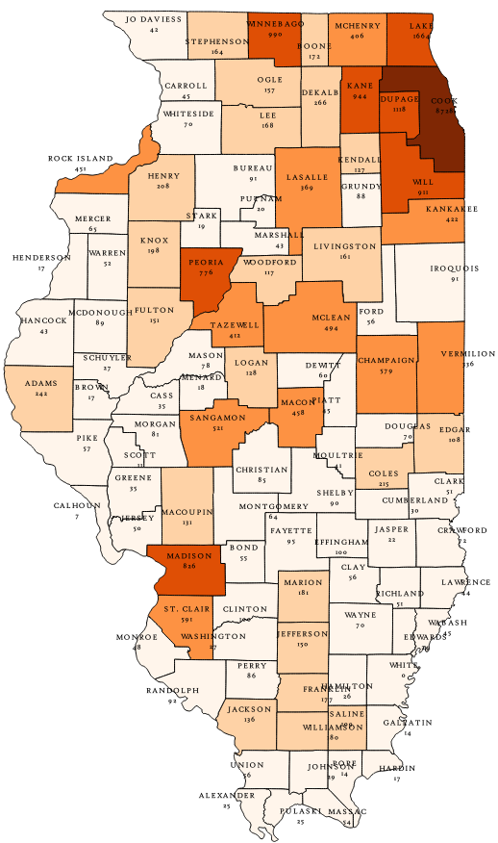
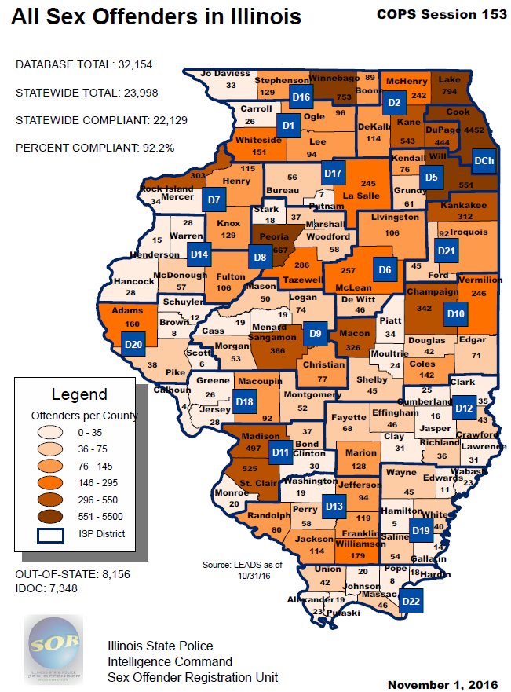
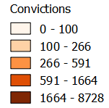
County
of Conviction
County
Of
Residence
Source: Illinois State Police
Source: ICJIA Analysis of Illinois State Police Registration Data, November 2016

Slide 21
Arrests for registerable sex offenses are a small proportion of the arrests each year
Average Number of Arrests 2013-2015
Arrests | Number | Percentage
May Require Registration | 4,689 | 1.13%
Does NOT Require Registration | 411,804 | 98.87%
Total | 416,493 | 100%
Average Number of People Arrested 2013-2015
People Arrested | Number | Percentage
May Be Required to Register | 4,446 | 1.46%
Are NOT Required to Register | 299,887 | 98.54%
Total | 304,334 | 100%
Source: ICJIA Analysis of CHRI Data

Slide 22
Age and race of arrestees for sex offenses tend to be similar to the average arrestee
Race of Arrestees for Registerable Sex Offenses in 2015
Median Age of Arrestee:
29
Median Age of Arrestee:
29
Source: ICJIA Analysis of CHRI Data

Slide 23
Juveniles currently registered are a small proportion of those in State secure facilities and on aftercare
A smaller proportion are on aftercare than are in State secure facilities
Source: ICJIA Analysis of IDJJ Data; June 2014

Slide 24
Persons convicted of sex offenses and persons currently registered are a small proportion of those in prison and on parole
A smaller proportion are on parole than are in prison
Source: ICJIA Analysis of IDOC Data; Prison June 2015, Parole June 2014

Slide 25
Some individuals do not have a place to live that complies with the State’s sex offender housing restrictions
These individuals are sometimes referred to as “gate violators”
Source: ICJIA Analysis of IDOC Data; Prison June 2015, Parole June 2014

Slide 26
The median age of sex offenders residing in prison or on parole is the same
A higher percentage of persons in prison were African American than on parole
Median Age:
41
Median Age:
41
Source: ICJIA Analysis of IDOC Data; Prison June 2015, Parole June 2014

Slide 27
The median age of registrants residing in a secure facility or on aftercare is similar
A higher percentage of persons on aftercare were white than in a secure facility
Median Age:
18
Median Age:
19
Source: ICJIA Analysis of IDJJ Data; June 2014

Slide 28
Data Limitations
What we do know
What we don’t know

Slide 29
Public Act 099-0873 (20 ILCS 3930/15 new) Sec. 15. Sex Offenses and Sex Offender Registration Task Force
(a) The General Assembly acknowledges that numerous criminal offenses that are categorized as sex offenses are serious crimes that affect some of the most vulnerable victims.
(1) The Sex Offender Database was created as a statewide database for the purpose of making information regarding sex offenders publicly available so that victims may be aware of released offenders and law enforcement may have a tool to identify potential perpetrators of current offenses. In addition to the Registry, sex offenders may be subject to specific conditions and prohibitions for a period after the person's release from imprisonment that restricts where the person may reside, travel, and work.

Slide 30
(2) The General Assembly recognizes that the current Sex Offender Database and sex offender restrictions do not assess or differentiate based upon the specific risks of each offender, potential threat to public safety, or an offender's likelihood of re-offending.
(3) The General Assembly believes that a Task Force should be created to ensure that law enforcement and communities are able to identify high-risk sex offenders and focus on monitoring those offenders to protect victims, improve public safety, and maintain the seriousness of each offense.

Slide 31
(b) The Sex Offenses and Sex Offender Registration Task Force is hereby created.
(1) The Task Force shall examine current offenses that require offenders to register as sex offenders, the current data and research regarding evidence based practices, the conditions, restrictions, and outcomes for registered sex offenders, and the registration process.
(2) The Task Force shall hold public hearings at the call of the co-chairpersons to receive testimony from the public and make recommendations to the General Assembly regarding legislative changes to more effectively classify sex offenders based on their level of risk of re-offending, better direct resources to monitor the most violent and high risk offenders, and to ensure public safety.

Slide 32
Charge, Meeting Schedule and Deliverables
Series of meetings
Examine current offenses that require offenders to register as sex offenders
Expert and public testimony from all perspectives
Research presentation
Current data
Evidence based practices
Written report of findings and recommendations to the General Assembly on or before January 1, 2018
More effectively classify sex offenders based on their level of risk of re-offending
Better direct resources to monitor the most violent and high risk offenders
Ensure public safety

